Slide 1
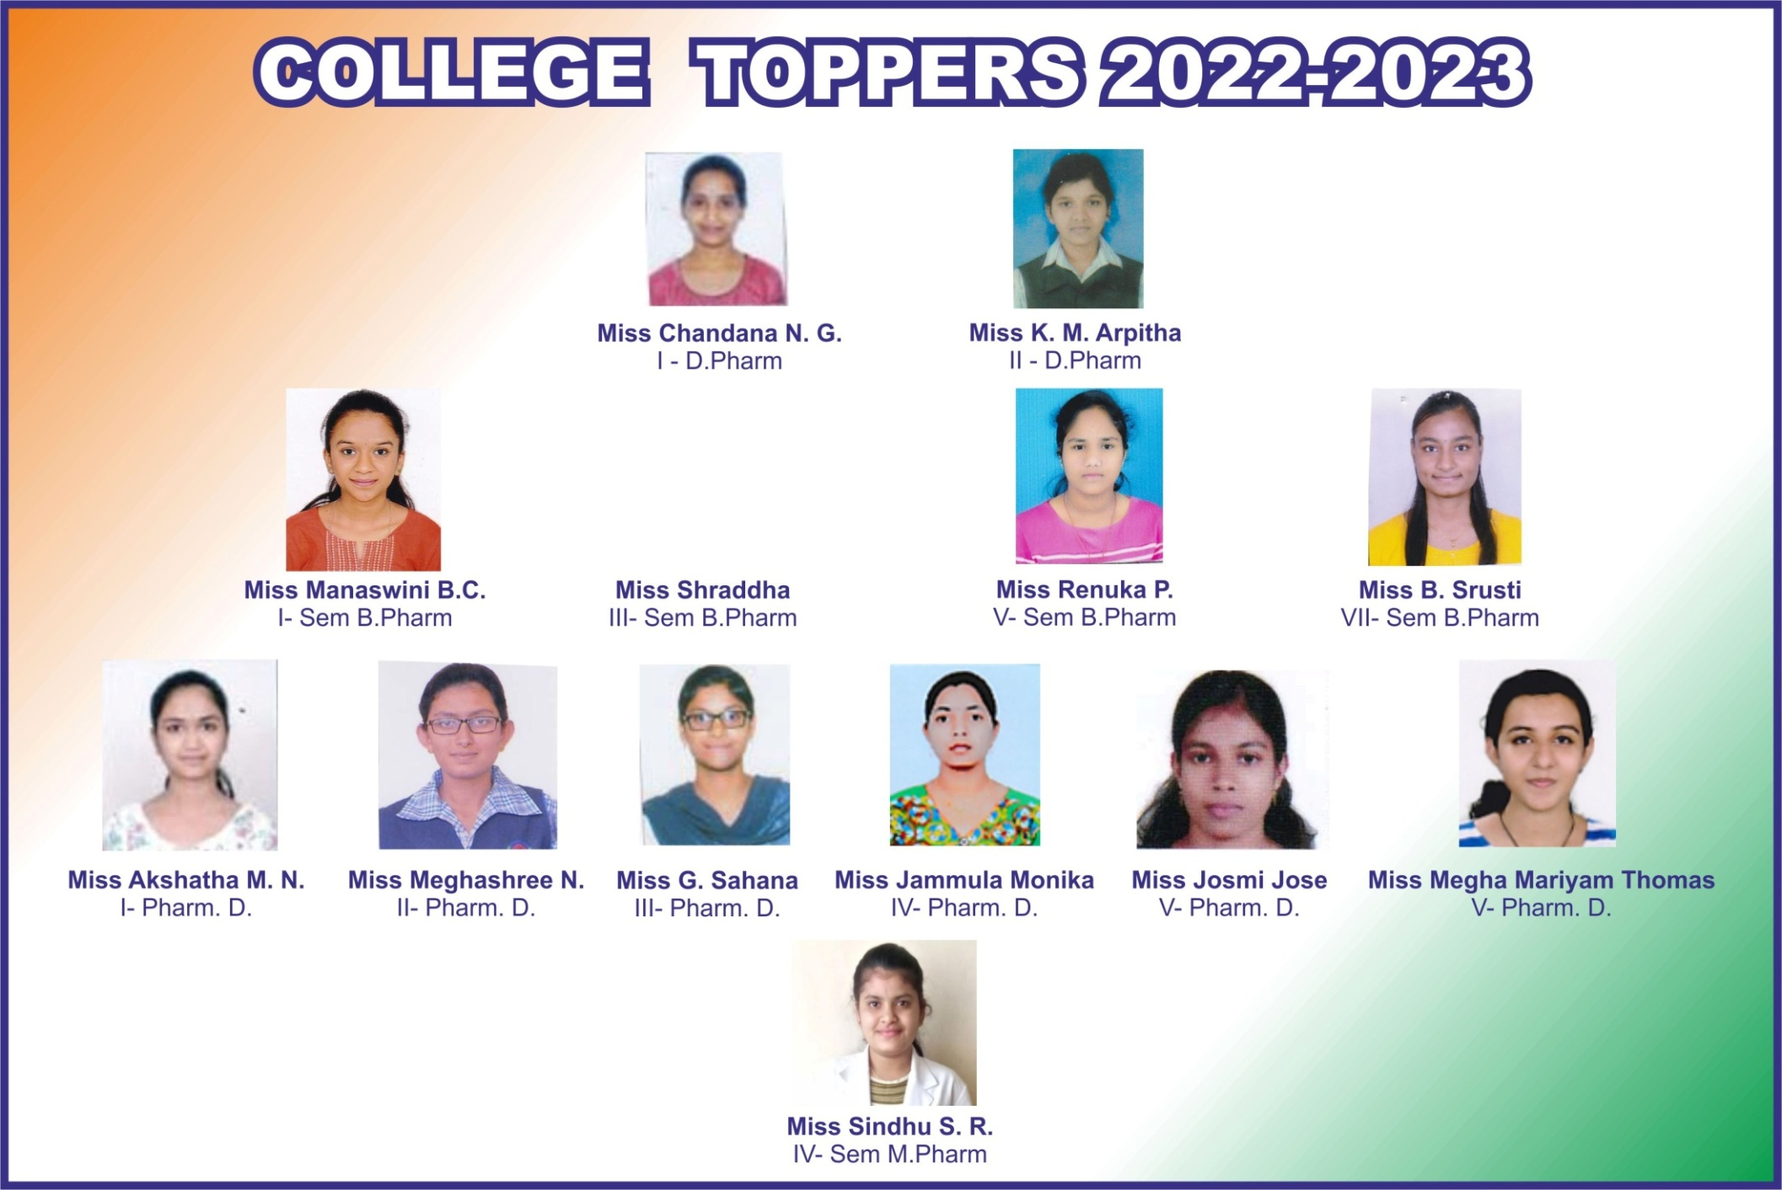
https://bapujipharmacy.org/aboutcollege.php

Slide 3
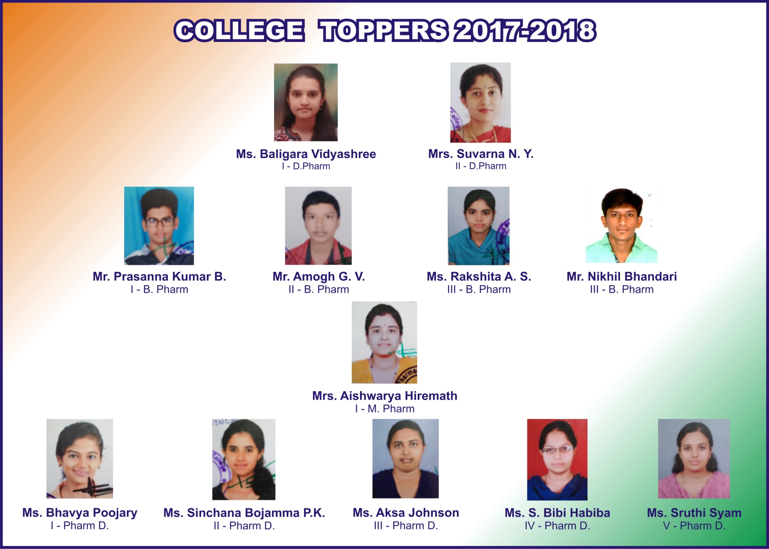

Slide 4
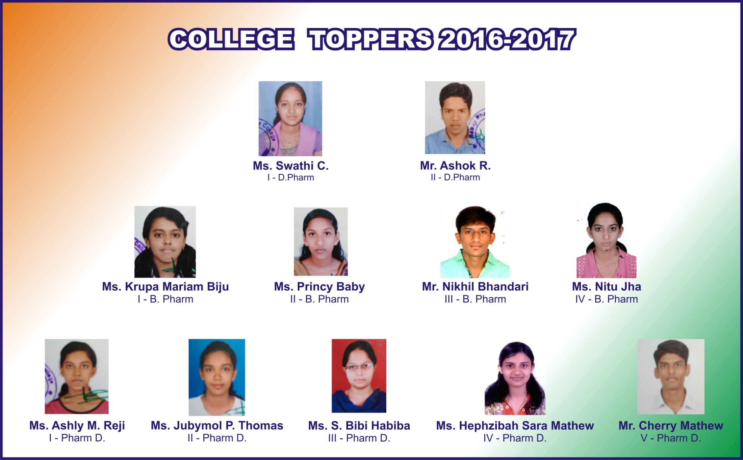

Slide 5
College Toppers – 2015-16

Slide 6
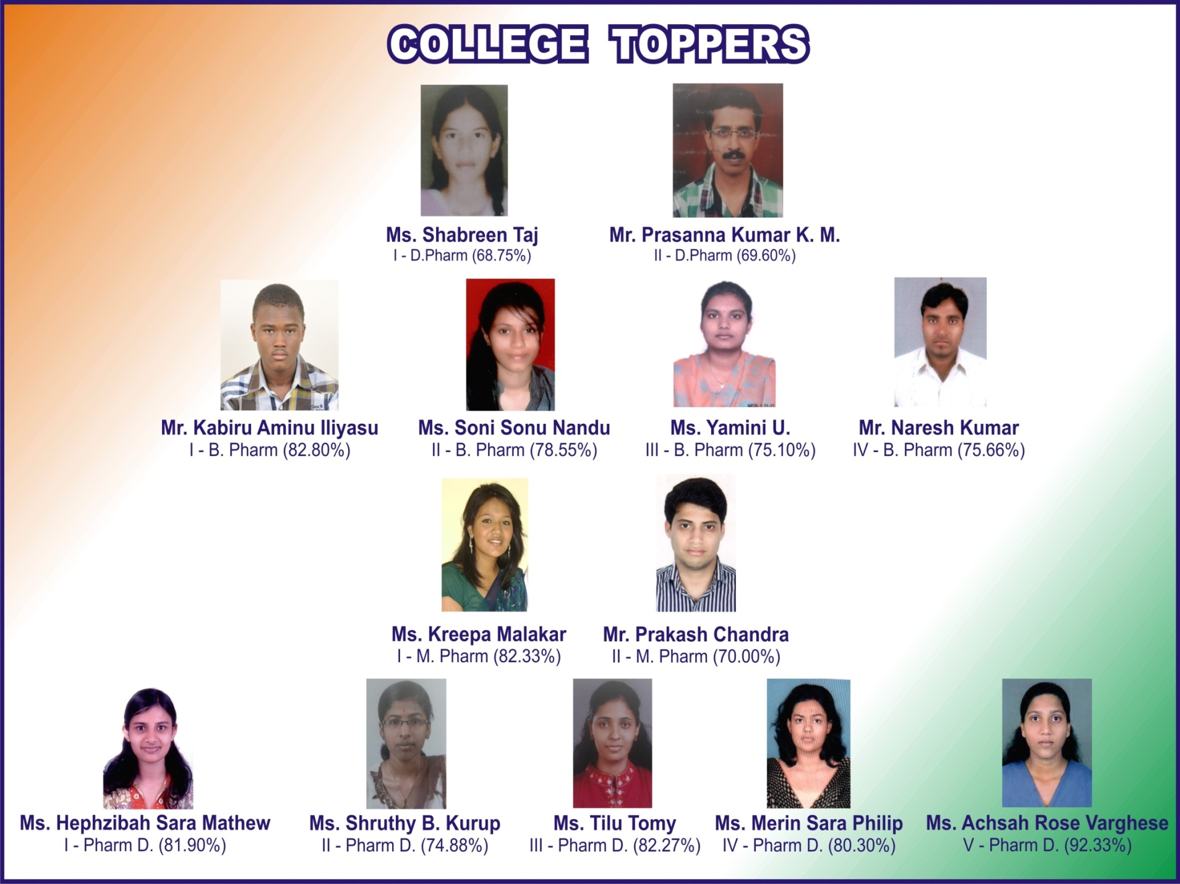
College Toppers – 2015

Slide 7
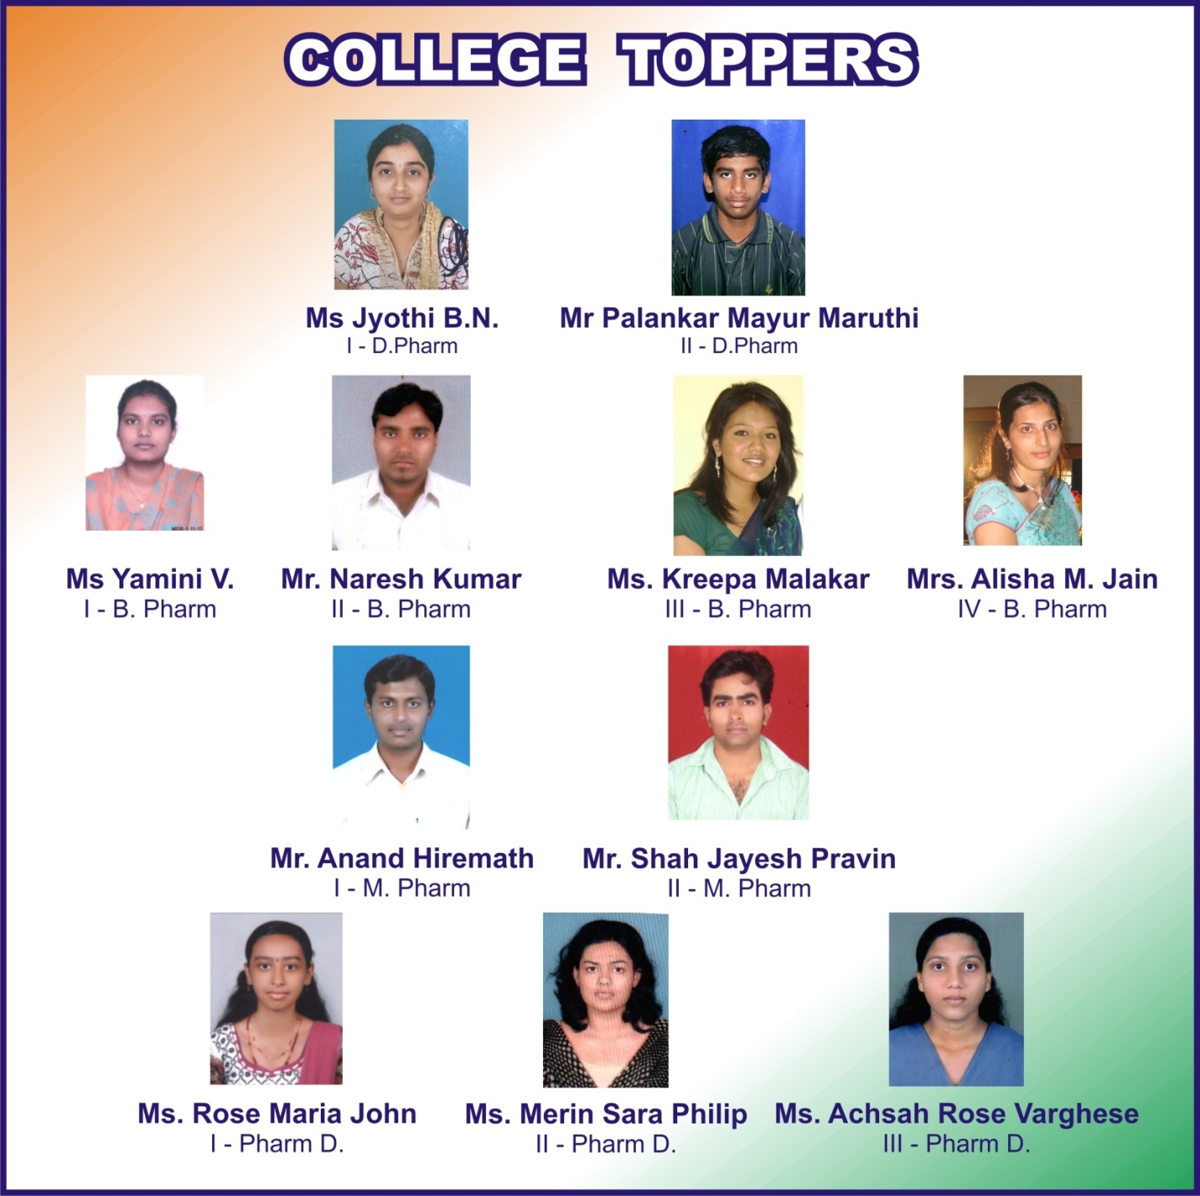
College Toppers – 2013

